Slide 1
SALARY PREDICTION
Notes:
hello everyone, my presentation is about Salary Prediction.
Salaries in the field of data professions vary widely based on factors such as experience, job role, and performance. Accurately predicting salaries for data professionals is essential for both job seekers and employers.
Using the given dataset, I have trained a model to predict the salary of an employee with high accuracy. Before presenting the modeling results, I would like to share some information using graphs so that you gain a basic understanding of our data."

Slide 2
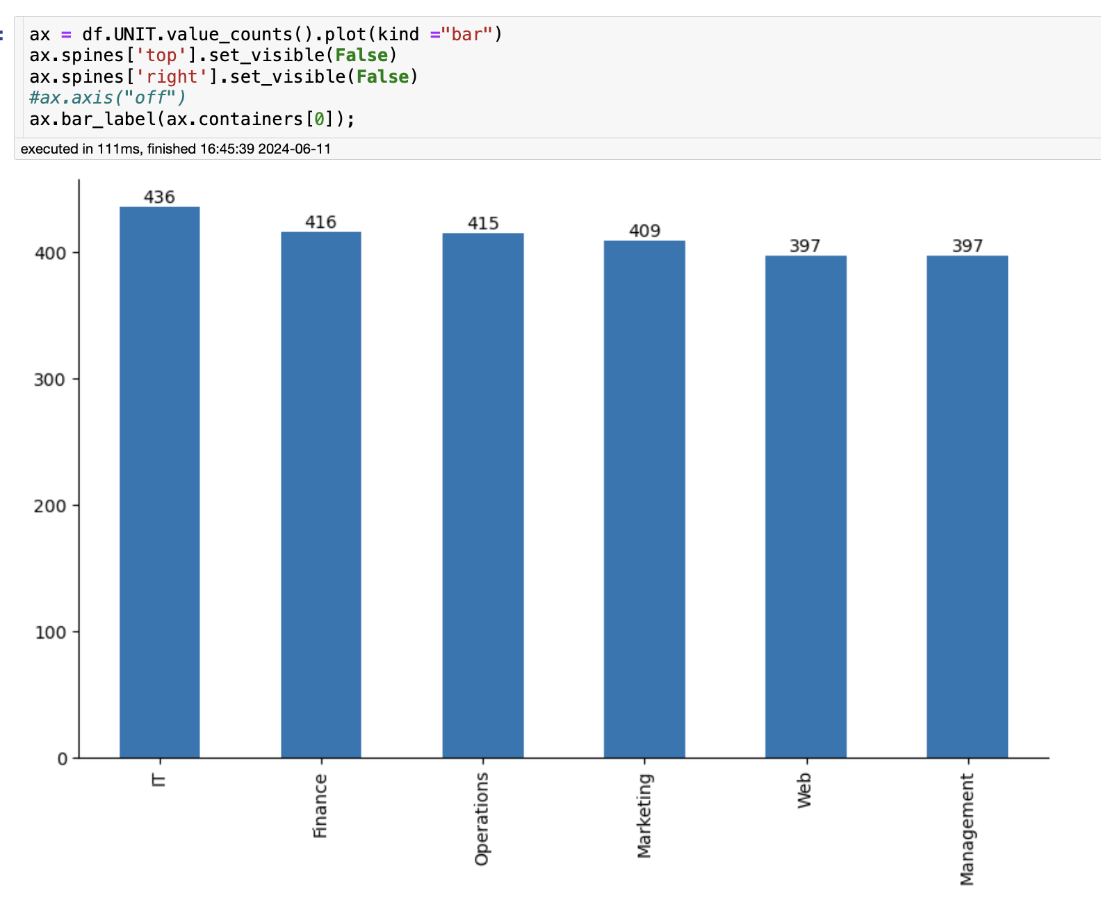

Slide 3
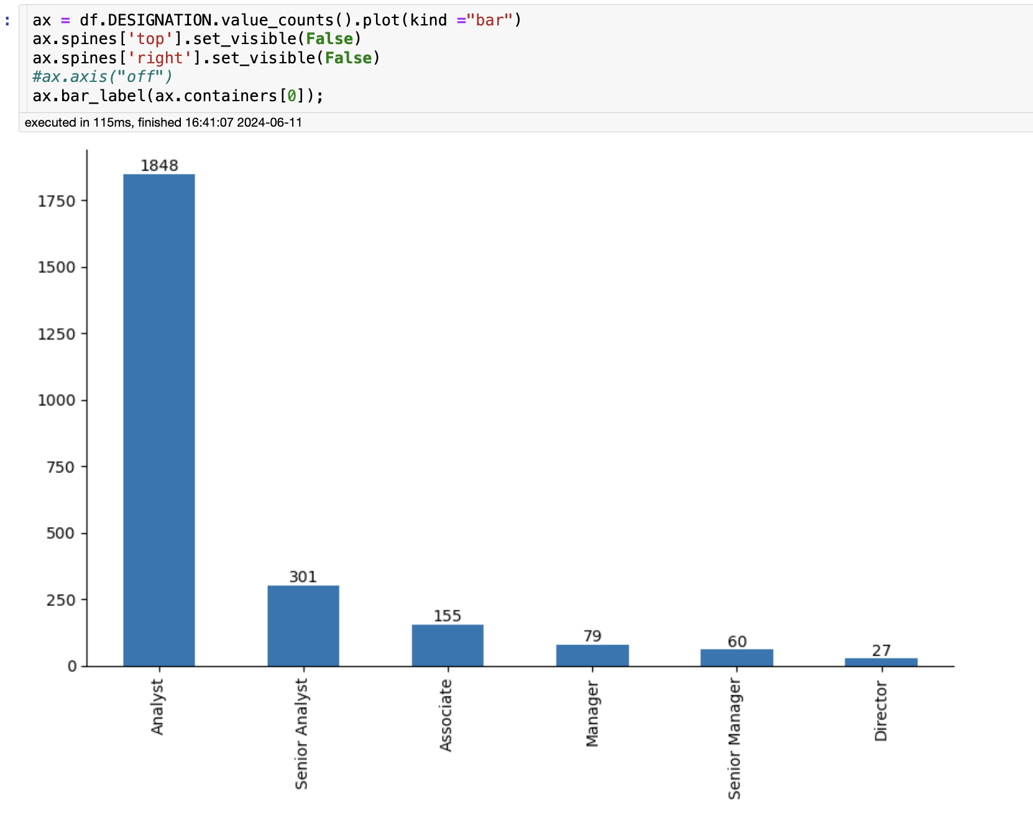

Slide 4
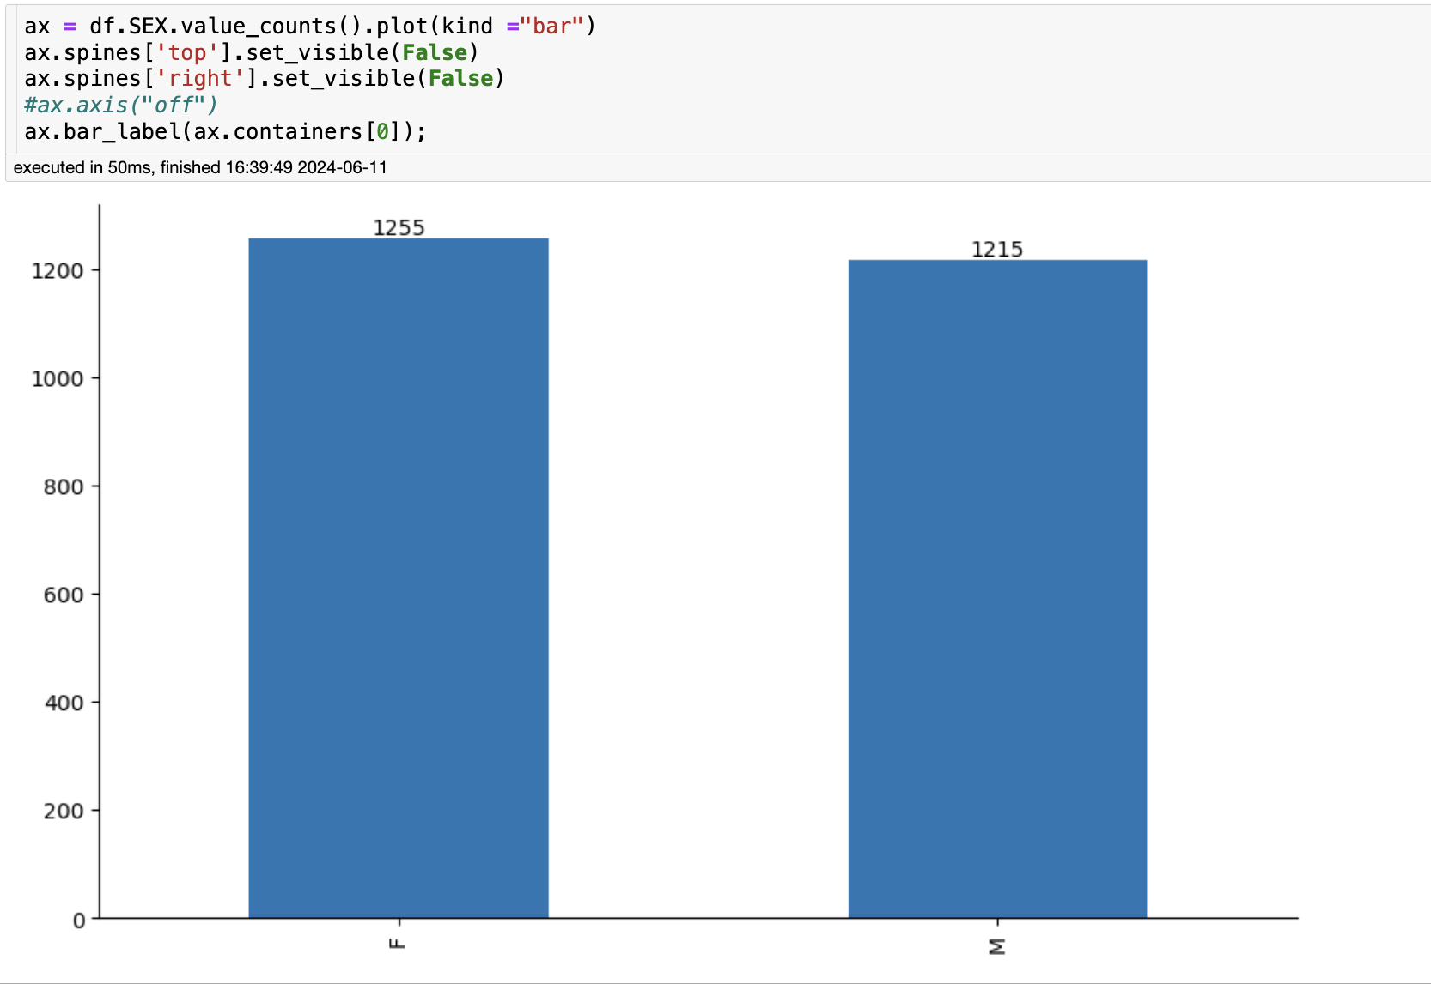

Slide 5
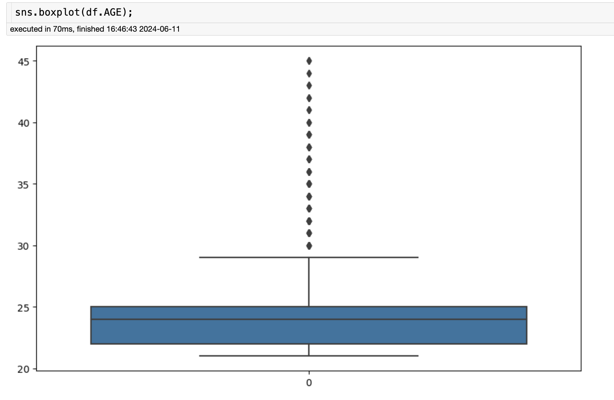

Slide 6
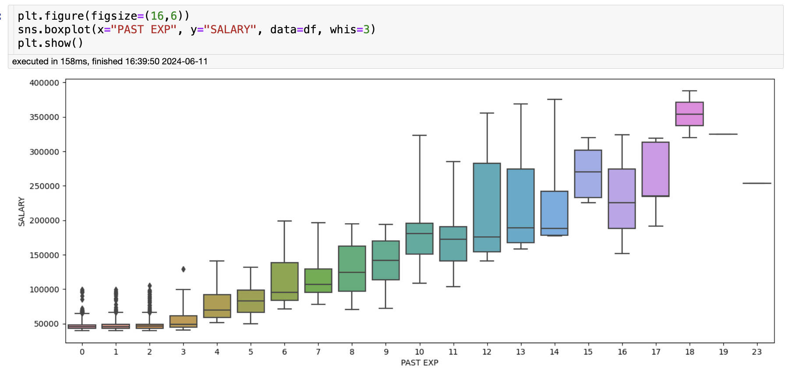

Slide 7
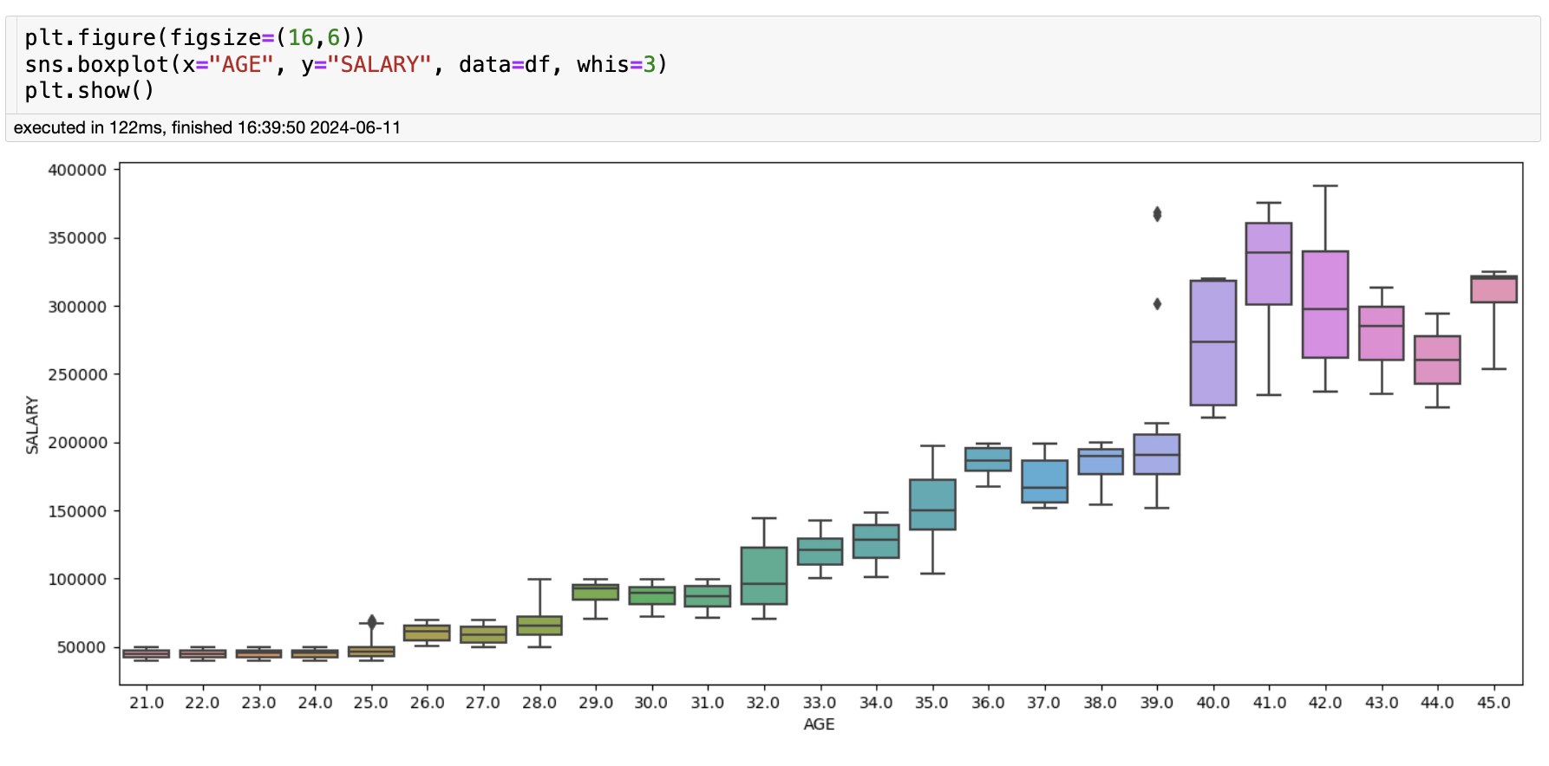

Slide 8
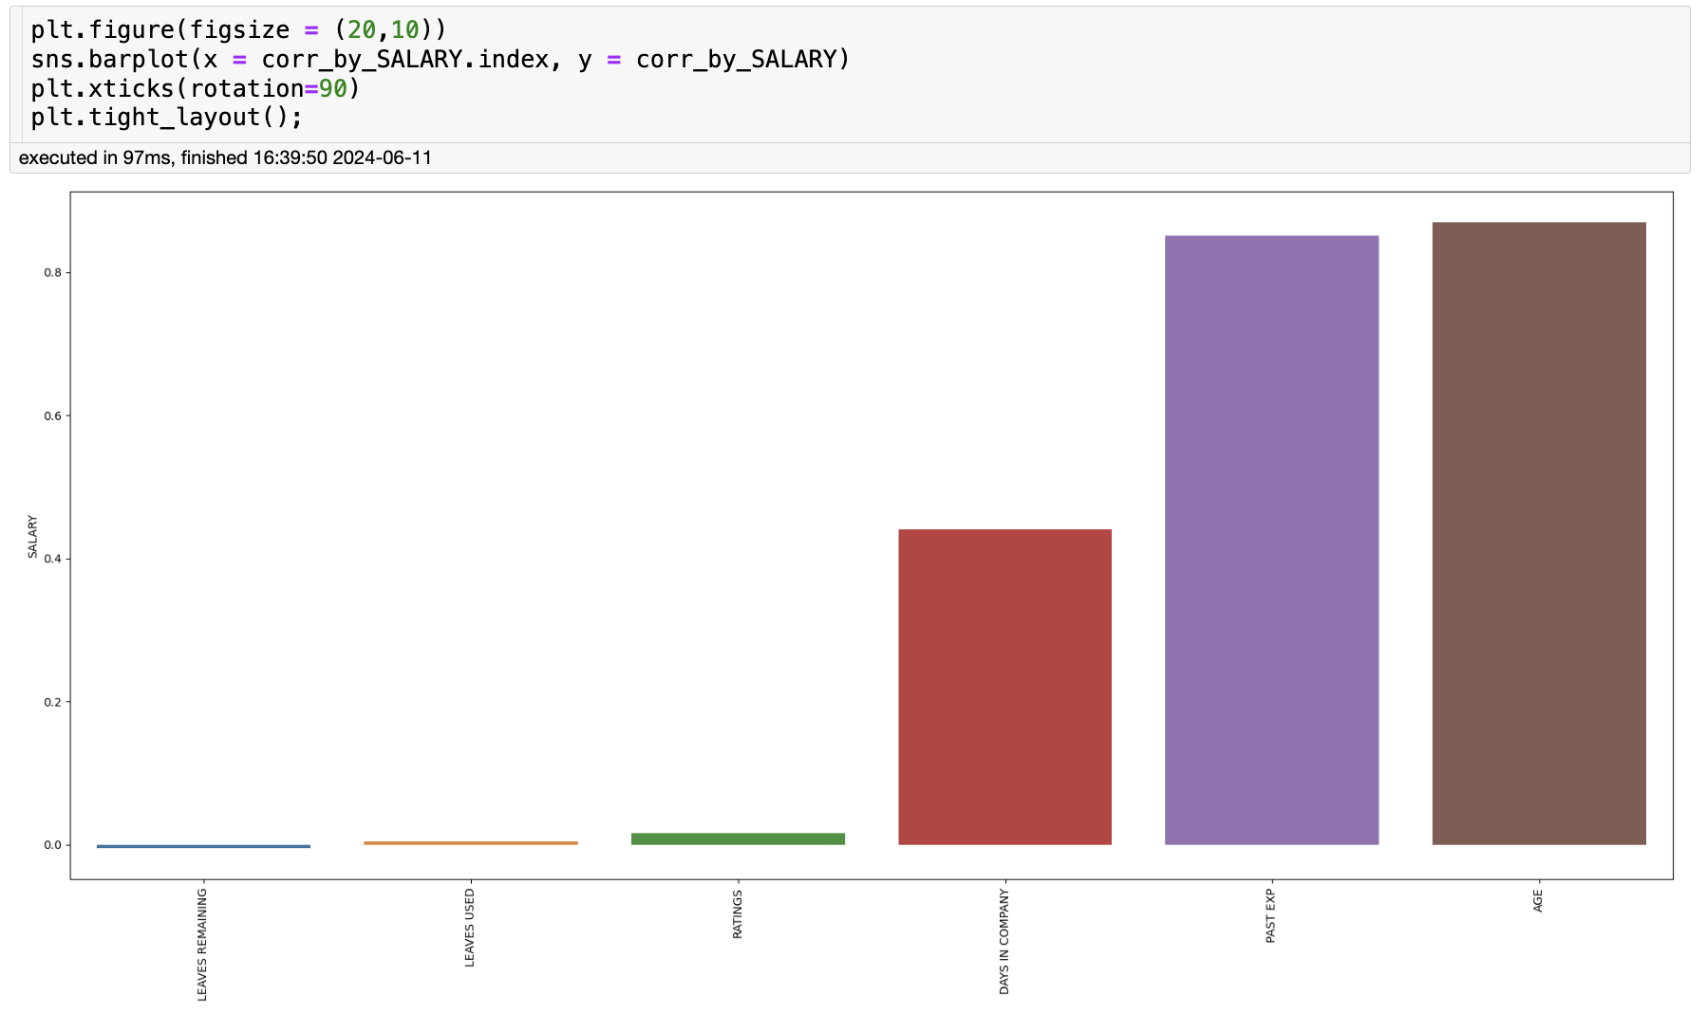

Slide 9
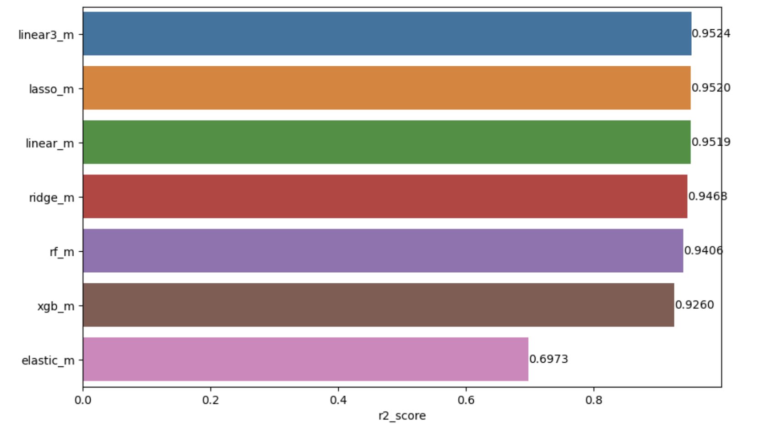
Model Comparing

Slide 10
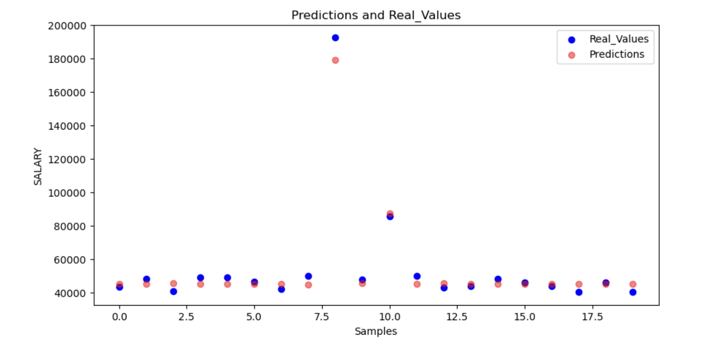

Slide 11
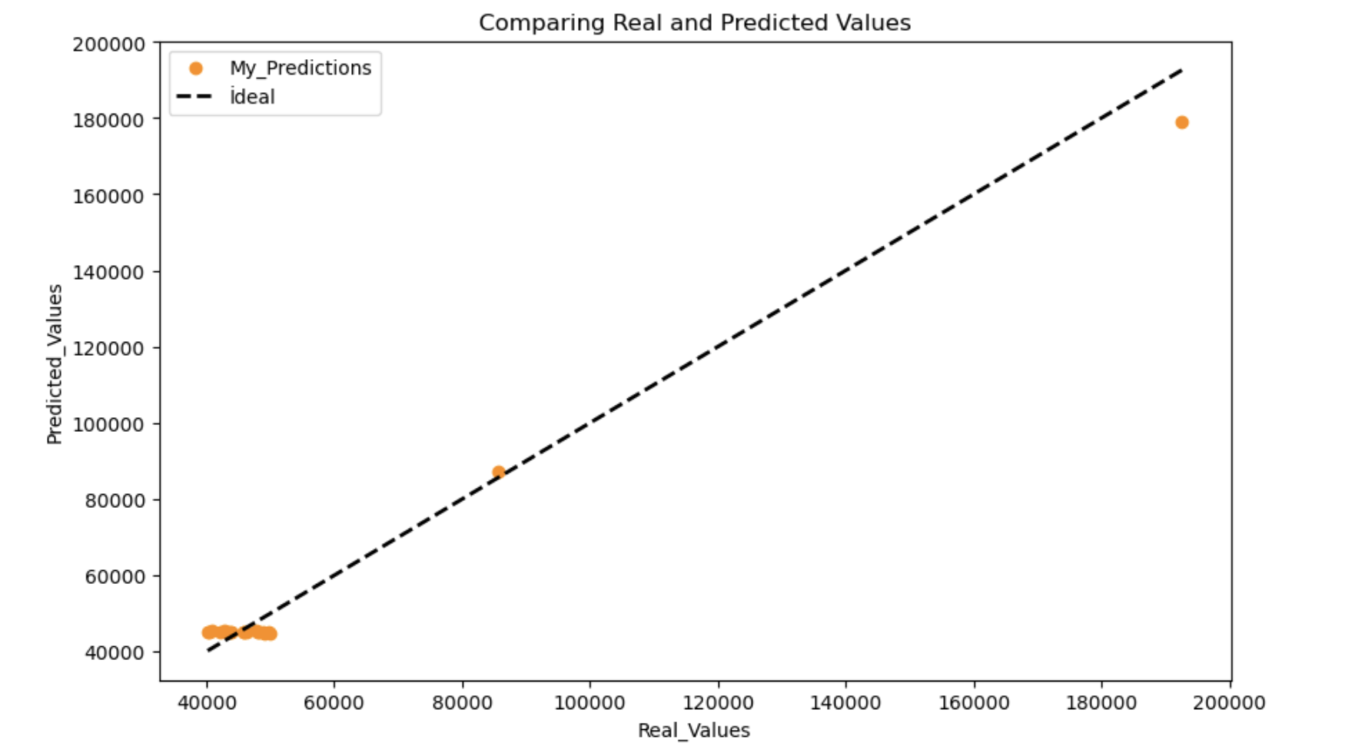

Slide 12
Predict Salary

Slide 13
Suggestions for Future Steps
1. Regular Updates and Maintenance:
Ongoing Data Collection: "We will regularly update our dataset with new salary data and trends from industry reports and surveys."
Model Retraining: "Schedule quarterly model retraining sessions to adapt to changing market conditions."
2. Expand Feature Set:
Additional Data Sources: "Integrate economic indicators and industry-specific data to capture broader market influences on salary trends."
Domain-Specific Features: "Collaborate with department heads to identify and include more relevant features specific to each tech role."
3. User Engagement:
Feedback Loop: "Establish a formal process for employees to provide feedback on salary predictions and adjust the model accordingly."
Transparency: "Create a user-friendly dashboard that explains how salary predictions are made, increasing transparency and trust."
with HR Systems: "Integrate the model with our existing HR systems to streamline operations and improve data utilization.”

Slide 14
4. Bias and Fairness Audits:
Regular Audits: "Conduct bi-annual audits to detect and mitigate any potential biases, ensuring equitable salary predictions."
Ethical Guidelines: "Develop ethical guidelines for the use of our salary prediction model, focusing on fairness and transparency."
5. Scalability and Deployment:
Scalable Infrastructure: "Upgrade our infrastructure to handle larger datasets and increased user load efficiently."
Integration
*** Future Roadmap:
"Our roadmap includes integrating broader economic data, enhancing model transparency, and ensuring continuous improvements through regular updates and user feedback."

